Slide 1
Lab 7: Phylogenetics III – Bayesian Methods and MCMC
Slides stolen shamelessly from Steve Mussmann, Jeff Silberman, and Jeremy Beaulieu

Slide 2

ML: Searches tree space to maximize the quantity:
$$L=P\left(D | M\right)$$

Slide 3
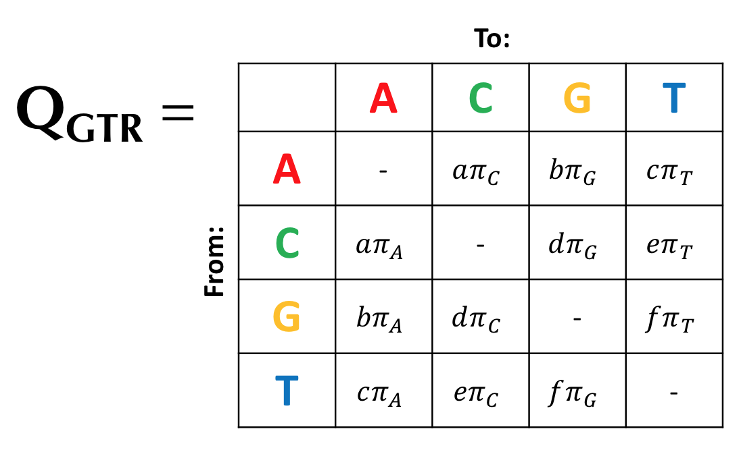
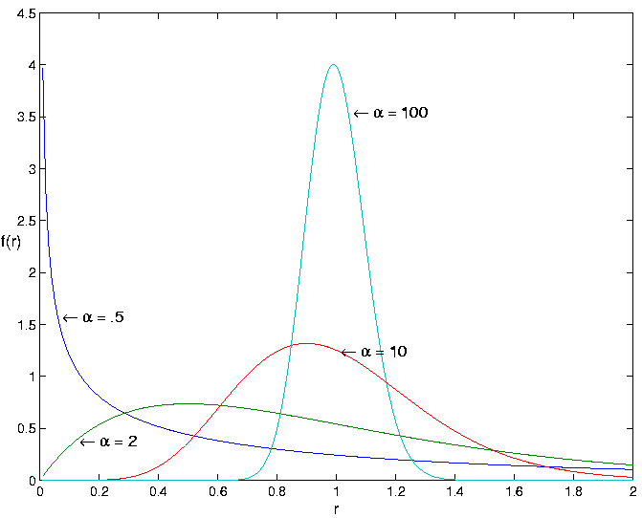
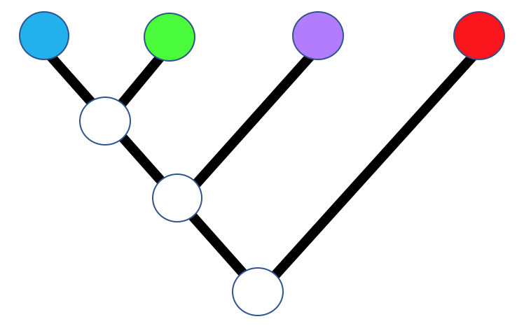
ML: Searches tree space to maximize the quantity:
$$L=P\left(D | M\right)$$

Slide 4
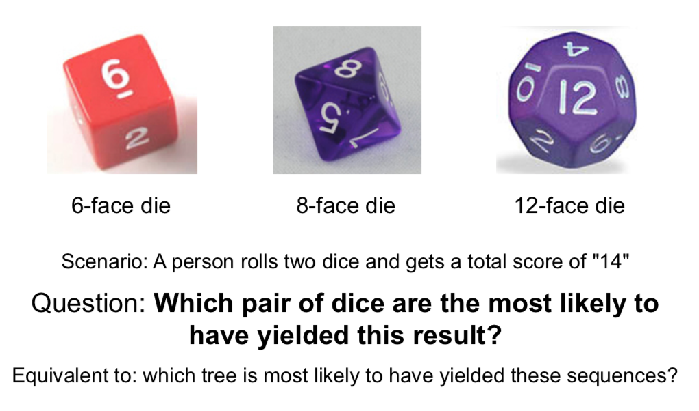
Likelihood = probability that a model gives rise to some data
In this case, the likelihood we calculate is: the probability that a combination of dice gives rise to a dice roll of “14”

Slide 5
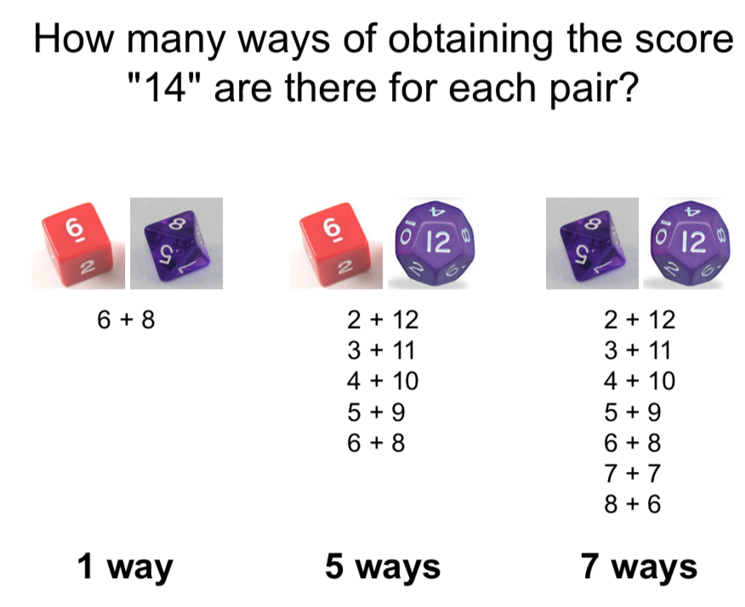
To figure this out, we need to know how many way each “model” could create our “data” (a roll of 14)

Slide 6
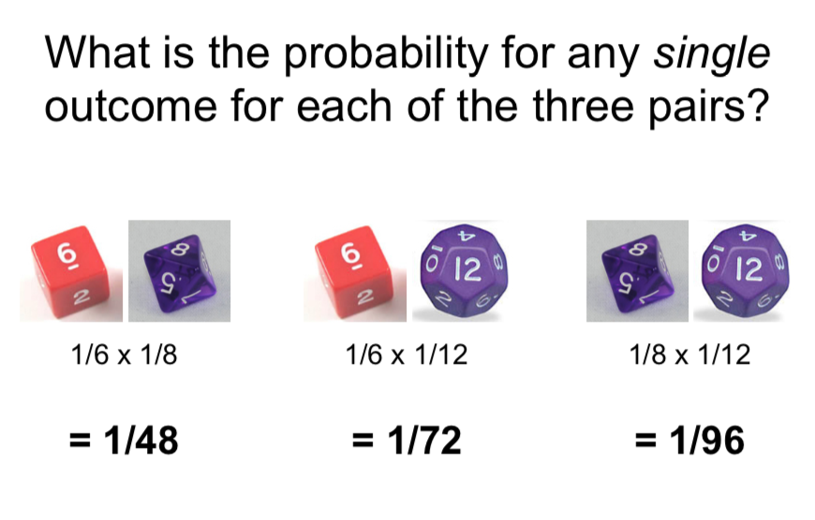
…And we need to know the probability of any outcome (e.g. 14) for each model

Slide 7
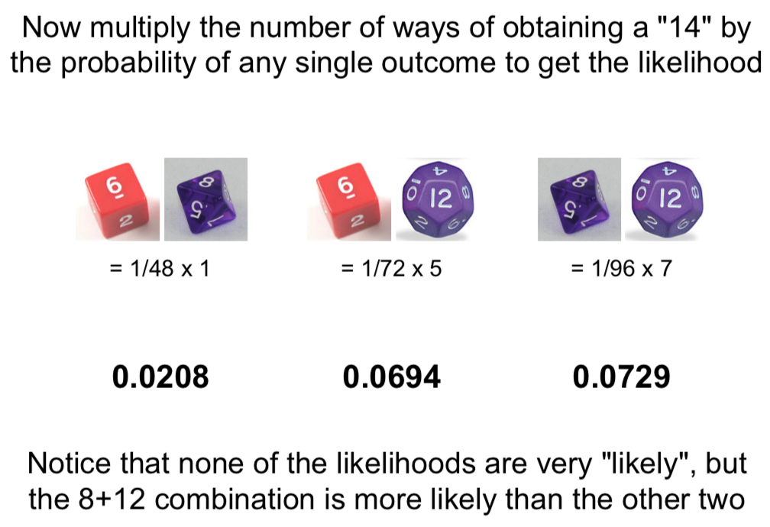
Credit: I stole this from Jeff Silberman’s 2012 UARK Molecular Phylogenetics course

Slide 8
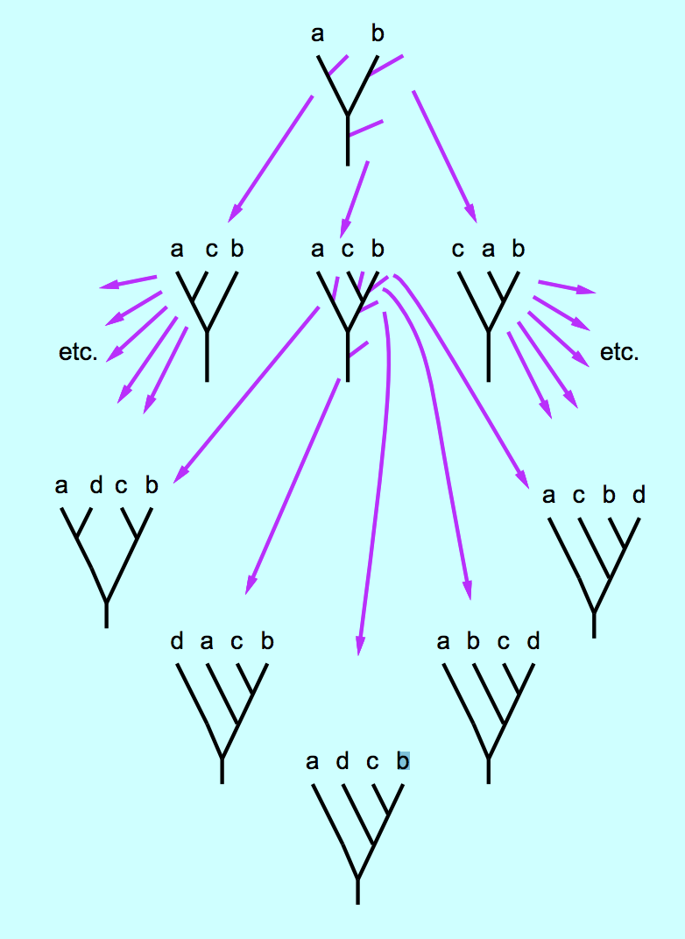
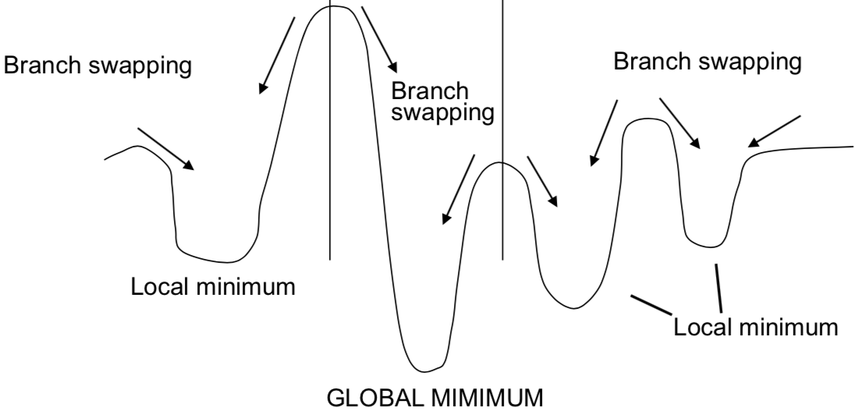
Goal: Search tree space
Can’t directly compute best tree
Can’t explore all trees
Need heuristic
Fig from Joe Felsenstein Genome 541 course, U Washington

Slide 9
Maximum Parsimony process
“Optimality criterion”
Model (tree)
Calculate tree length
Compare models

Slide 10
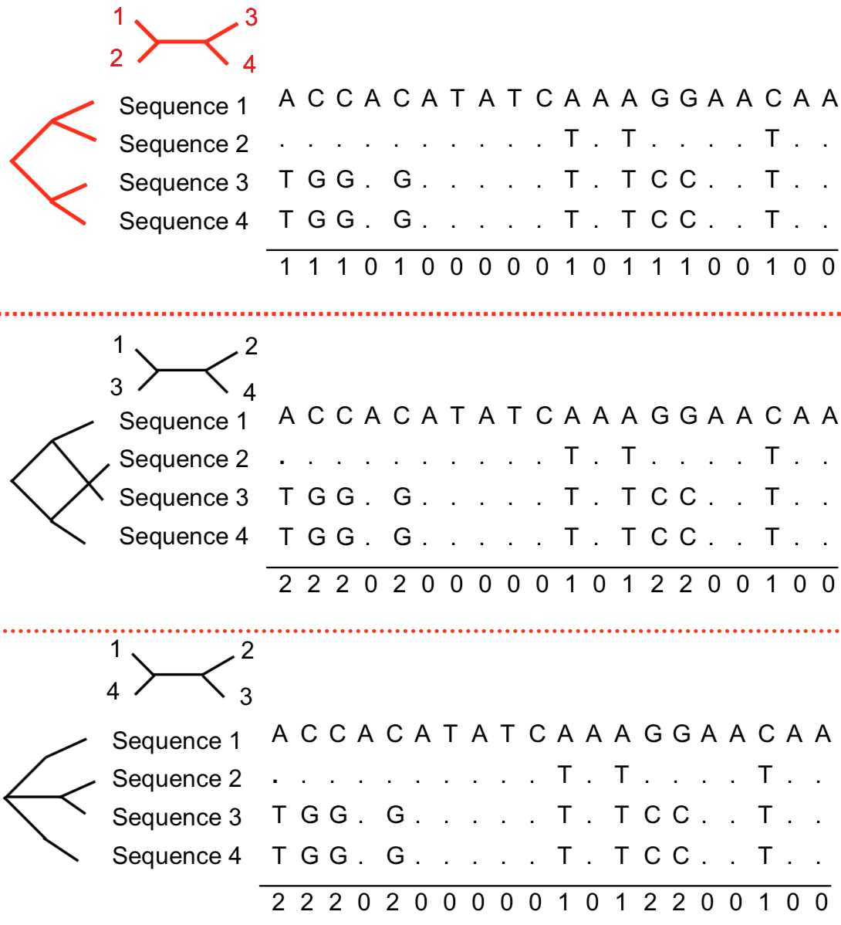
Sum up changes needed for each tree = tree length
TL = 9
TL = 15
TL = 15

Slide 11
When does MP fail?
Consider the following “TRUE” phylogeny, with branch lengths as number of total substitutions:

Slide 12
Considering a single nucleotide site…
Given branch lengths and known ancestral states..
C→T
A→C
C→T
T→A
A→T
A→C
A
G
G→A

Slide 13
Observed matrix for nucleotide position #1
Homoplasy along long branches
Alignment
C→T
A……
A→C
T……
C→T
T→A
T……
A→T
A→C
G……
A
G
G→A
MPR for site 1

Slide 14
This process is referred to as “long-branch attraction”
Summed over the tree can lead to incorrect topologies… Maximum parsimony is particularly vulnerable
Caused by homoplasy

Slide 15
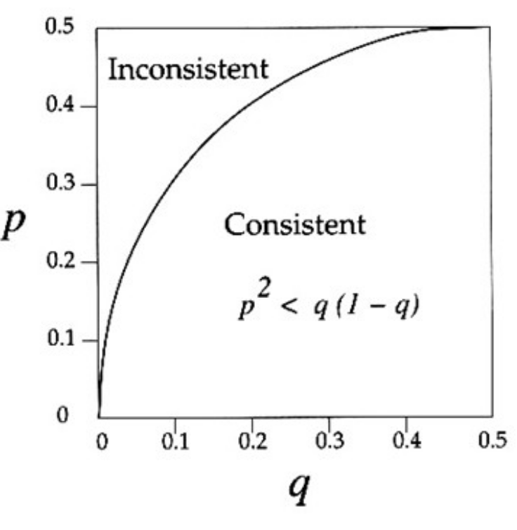
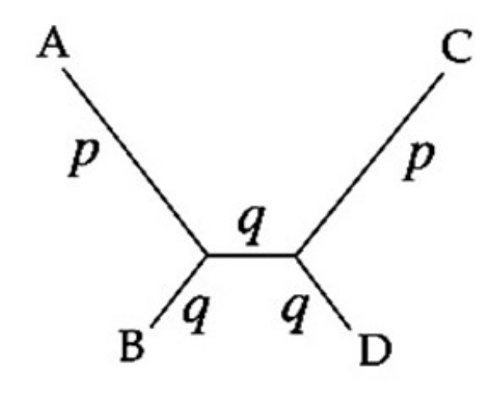
“Felsenstein Zone”
Portion of treespace most vulnerable to LBA
Joe Felsenstein
p, q = prob of observing change along branch
e.g. branch length

Slide 16
“Felsenstein Zone”
Portion of treespace most vulnerable to LBA
Joe Felsenstein
Prob of LBA higher as p increases, and q decreases

Slide 17
How to mitigate?
C→T
Need to consider probability of changes along branches
To do that, we need a model of how often different changes occur
A→C
C→T
T→A
A→T
A→C
A
G
G→A

Slide 18
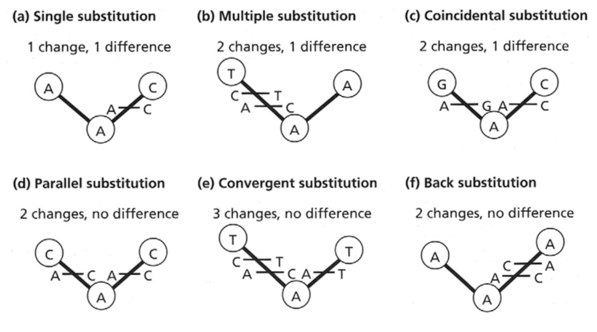
As we’ve seen… many different (and some not-so-obvious) ways change can occur

Slide 19
IMPORTANT
As time increases, the observed number of differences between two sequences becomes an increasingly poor estimator of the actual number of differences that occurred

Slide 20
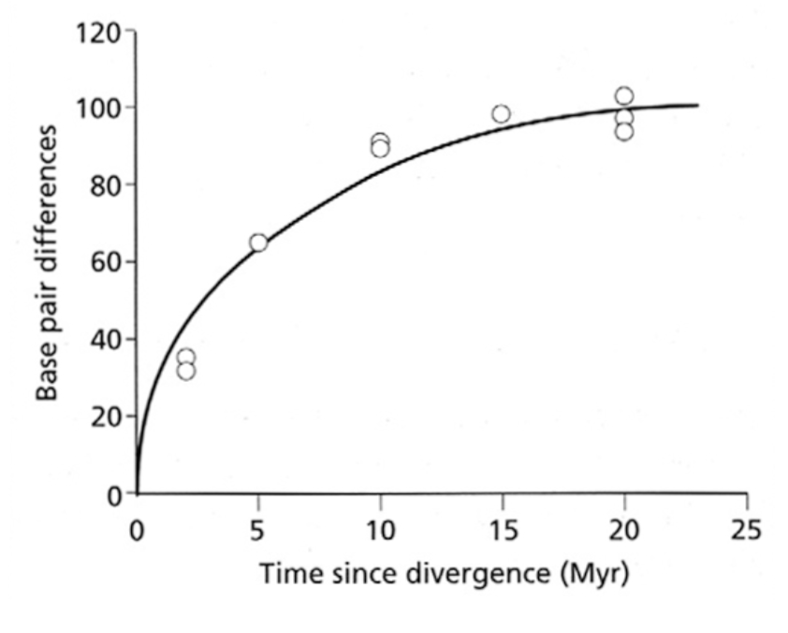
Sequence “saturation”
1 my
5 my
10 my
Relationship between number of observed differences and time since divergence is non-linear
There are only 4 possible states [ACGT] and a finite number of sites (nucleotides sampled). Over time, multiple substitutions will occur.

Slide 21
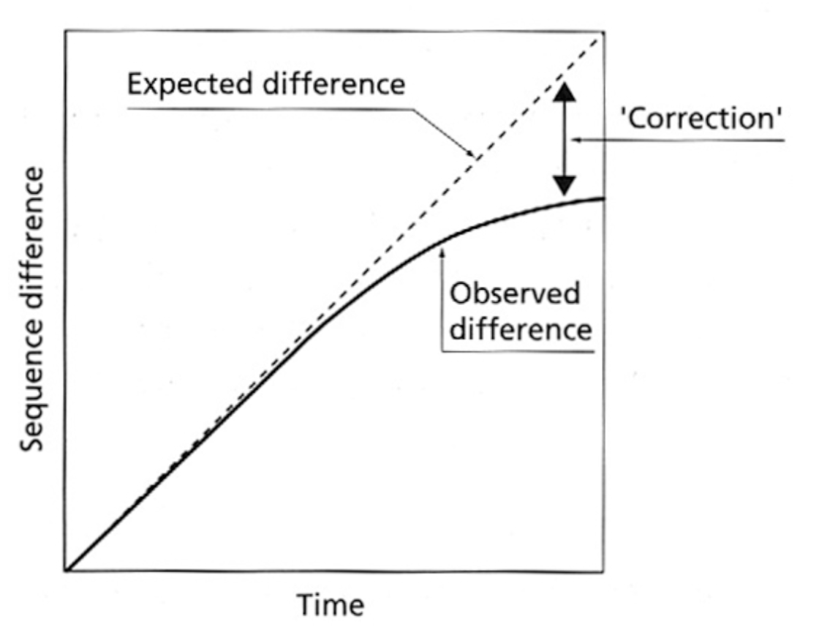
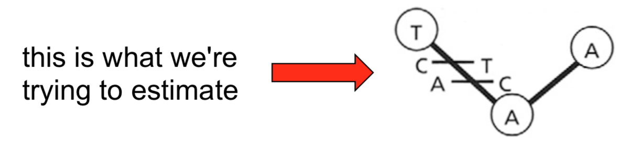
Sequence “saturation”
Need to incorporate knowledge of how often different types of substitutions occur…
…To estimate how many mutations we’ve missed

Slide 22
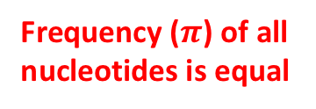
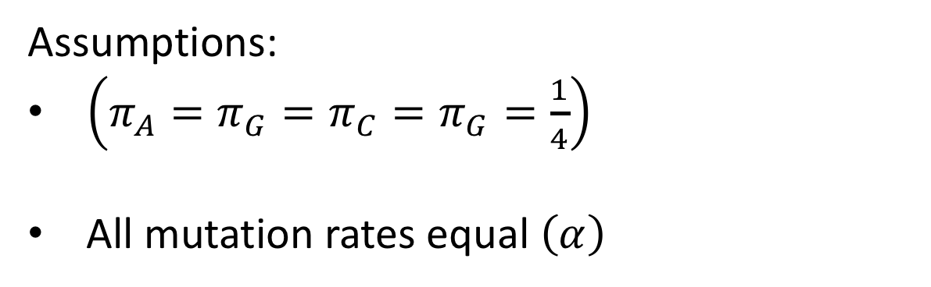
Simplest model: Jukes-Cantor (1969)
Assumptions:
$\left(π_{A}=π_{G}=π_{C}=π_{G}=\frac{1}{4}\right)$
All mutation rates equal $\left(α\right)$
Frequency ($π$) of all nucleotides is equal

Slide 23
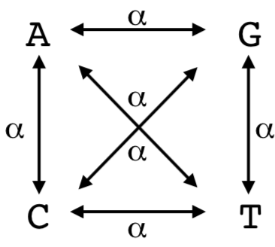
Simplest model: Jukes-Cantor (1969)
Assumptions:
$\left(π_{A}=π_{G}=π_{C}=π_{G}=\frac{1}{4}\right)$
All mutation rates equal $\left(α\right)$
Relative transition rates
(they’re all the same!)

Slide 24
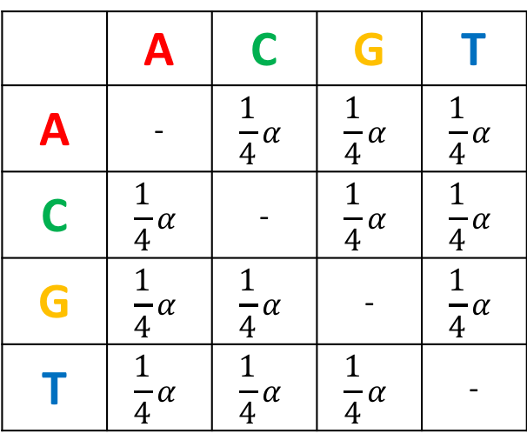
Simplest model: Jukes-Cantor (1969)
Assumptions:
$\left(π_{A}=π_{G}=π_{C}=π_{G}=\frac{1}{4}\right)$
All mutation rates equal $\left(α\right)$
Instantaneous rate matrix
To:
 | A | C | G | T
A | - | $$\frac{1}{4}α$$ | $$\frac{1}{4}α$$ | $$\frac{1}{4}α$$
C | $$\frac{1}{4}α$$ | - | $$\frac{1}{4}α$$ | $$\frac{1}{4}α$$
G | $$\frac{1}{4}α$$ | $$\frac{1}{4}α$$ | - | $$\frac{1}{4}α$$
T | $$\frac{1}{4}α$$ | $$\frac{1}{4}α$$ | $$\frac{1}{4}α$$ | -
Q_{JC} =
From:

Slide 25
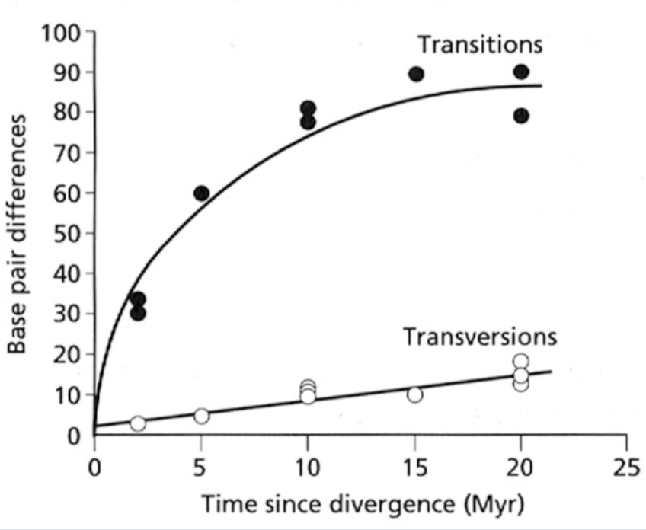
Problems with JC69?
We know transitions and transversions don’t occur at the same rate

Slide 26
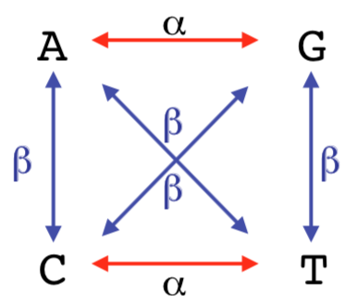
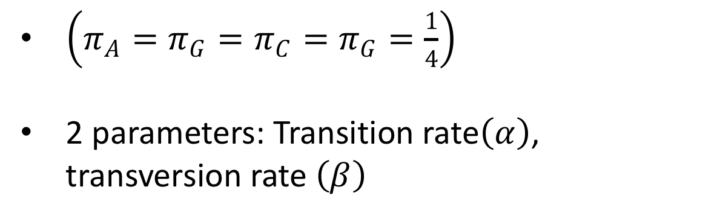
Kimura 2-Parameter (K2P; 1980)
$\left(π_{A}=π_{G}=π_{C}=π_{G}=\frac{1}{4}\right)$
2 parameters: Transition rate$\left(α\right)$, transversion rate $\left(β\right)$

Slide 27
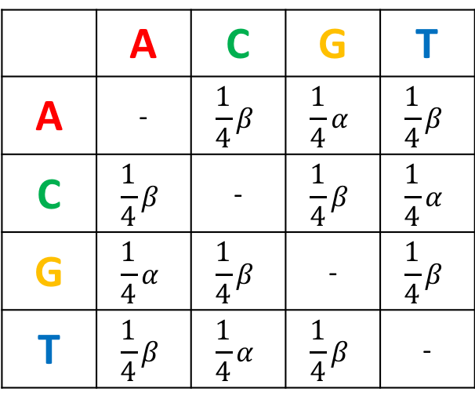
Kimura 2-Parameter (K2P; 1980)
$\left(π_{A}=π_{G}=π_{C}=π_{G}=\frac{1}{4}\right)$
2 parameters: Transition rate$\left(α\right)$, transversion rate $\left(β\right)$
To:
 | A | C | G | T
A | - | $$\frac{1}{4}β$$ | $$\frac{1}{4}α$$ | $$\frac{1}{4}β$$
C | $$\frac{1}{4}β$$ | - | $$\frac{1}{4}β$$ | $$\frac{1}{4}α$$
G | $$\frac{1}{4}α$$ | $$\frac{1}{4}β$$ | - | $$\frac{1}{4}β$$
T | $$\frac{1}{4}β$$ | $$\frac{1}{4}α$$ | $$\frac{1}{4}β$$ | -
Q_{K2P} =
From:
Instantaneous rate matrix

Slide 28
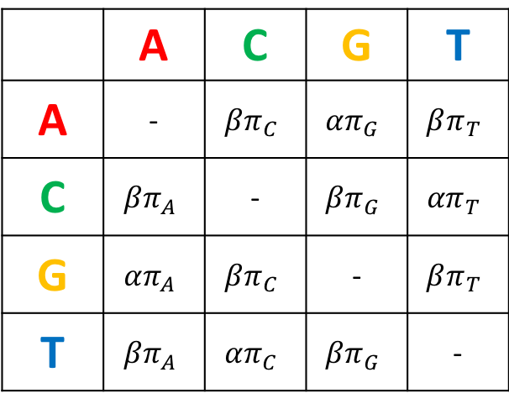
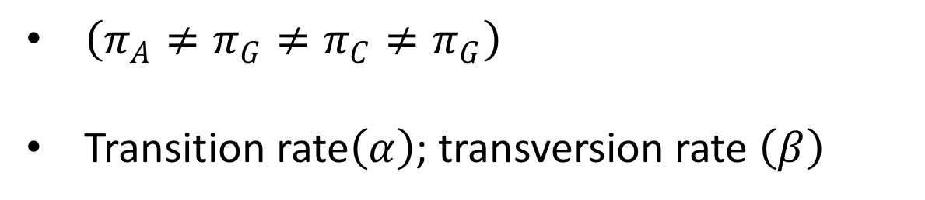
Hasegawa, Kishino, and Yano 1985 (HKY)
$\left(π_{A}≠π_{G}≠π_{C}≠π_{G}\right)$
Transition rate$\left(α\right)$; transversion rate $\left(β\right)$
To:
 | A | C | G | T
A | - | $$βπ_{C}$$ | $${απ}_{G}$$ | $$βπ_{T}$$
C | $$βπ_{A}$$ | - | $$βπ_{G}$$ | $${απ}_{T}$$
G | $${απ}_{A}$$ | $$βπ_{C}$$ | - | $$βπ_{T}$$
T | $$βπ_{A}$$ | $${απ}_{C}$$ | $$βπ_{G}$$ | -
Q_{HKY} =
From:

Slide 29
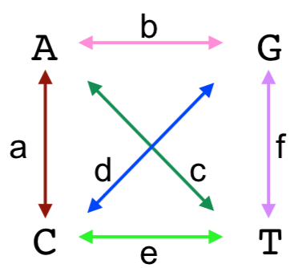
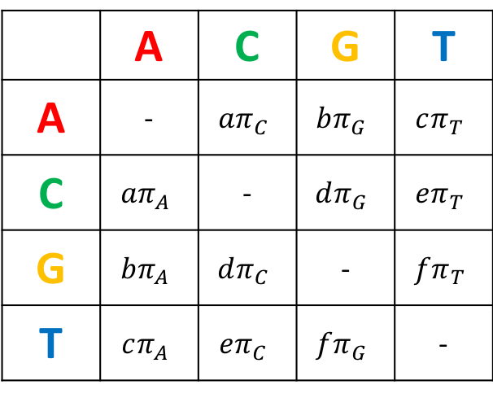
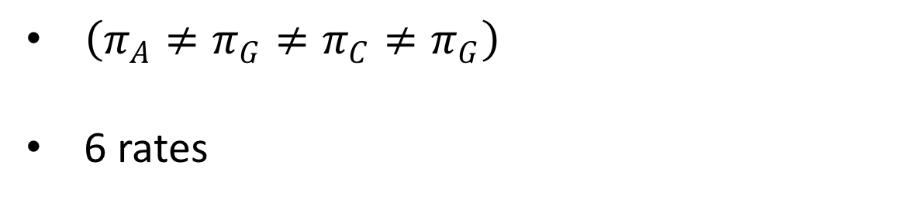
Generalized Time Reversible (GTR)
$\left(π_{A}≠π_{G}≠π_{C}≠π_{G}\right)$
6 rates
To:
Q_{GTR} =
 | A | C | G | T
A | - | $$aπ_{C}$$ | $${bπ}_{G}$$ | $$cπ_{T}$$
C | $$aπ_{A}$$ | - | $$dπ_{G}$$ | $${eπ}_{T}$$
G | $${bπ}_{A}$$ | $$dπ_{C}$$ | - | $$fπ_{T}$$
T | $$cπ_{A}$$ | $${eπ}_{C}$$ | $$fπ_{G}$$ | -
From:

Slide 30
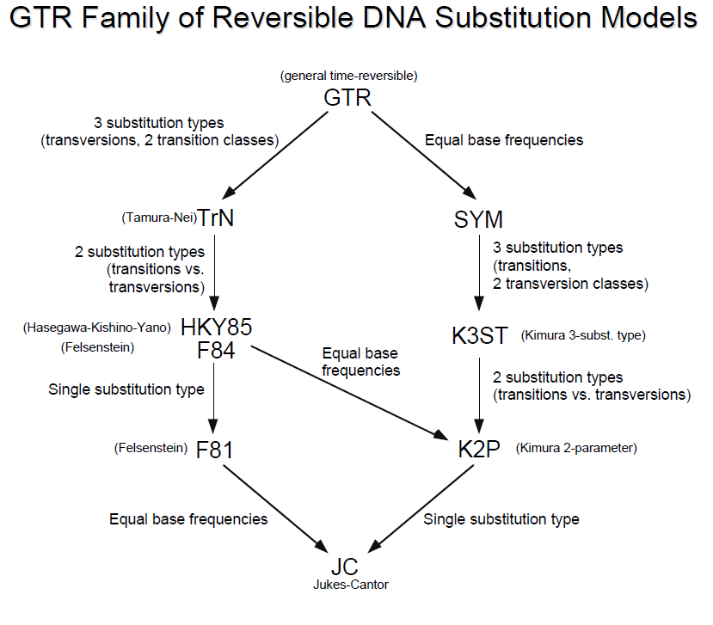

Slide 31
Making things hairier…
We can also relax the assumption that rates among sites is equal by allowing them to vary
Sample rates from a gamma distribution
Shape parameter 𝞪
Low 𝞪 = greater rate heterogeneity

Slide 32
Unrealistic aspects of the model
In reality, rates among neighboring sites tend to be autocorrelated (which is not considered)
Mathematically and computationally more convenient to assign rate “categories” rather than considering continuous distribution
Rates change through time
Gamma distribution not necessarily proven empirically to describe rate heterogeneity among sites

Slide 33
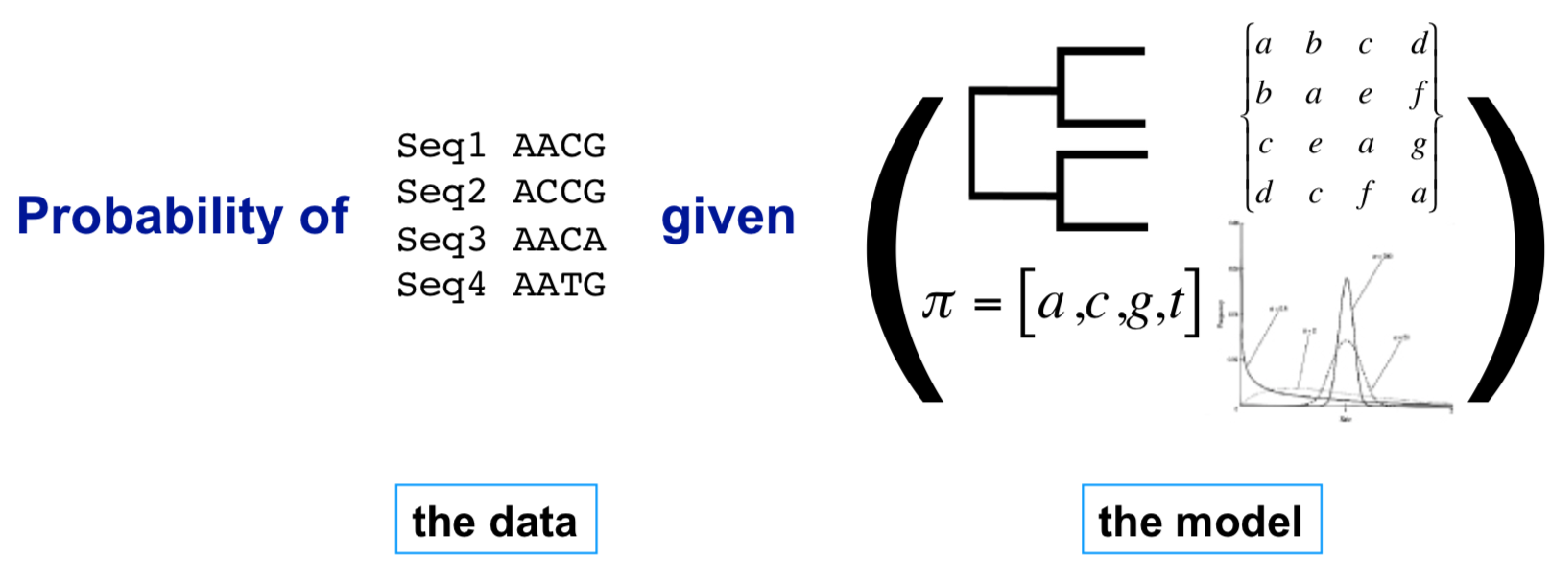
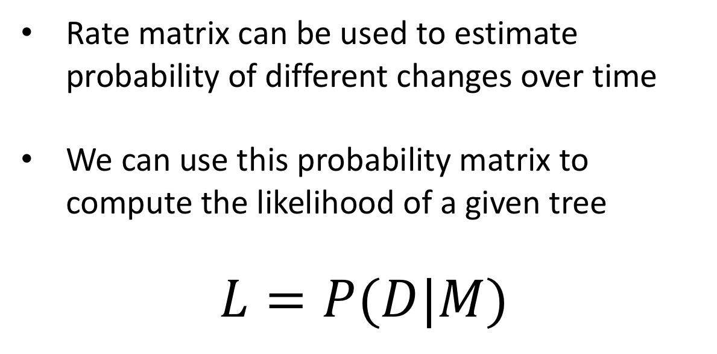
Why is this useful?
Rate matrix can be used to estimate probability of different changes over time
We can use this probability matrix to compute the likelihood of a given tree
$$L=P(D|M)$$

Slide 34
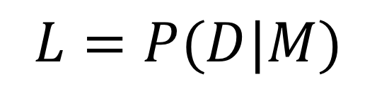
Maximum Likelihood searches tree space to maximize this quantity
“Optimality criterion”
Model (tree)
Compare models
$$L=P(D|M)$$
We still use branch swapping to explore possible trees, and use bootstrapping to assess support (just like with parsimony), but we use a different optimality criterion to compare models (trees)

Slide 35
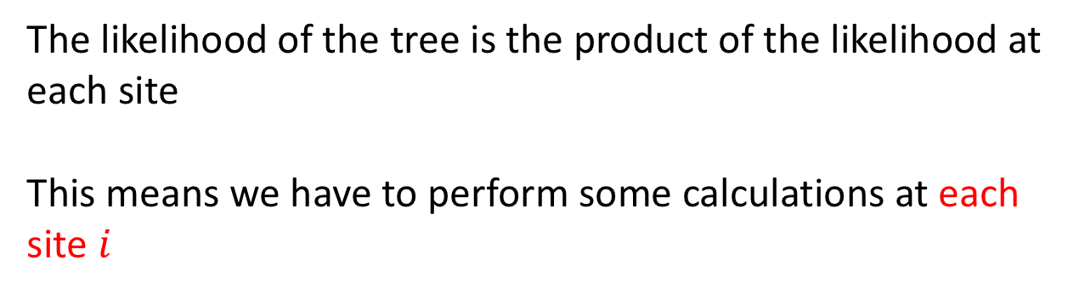
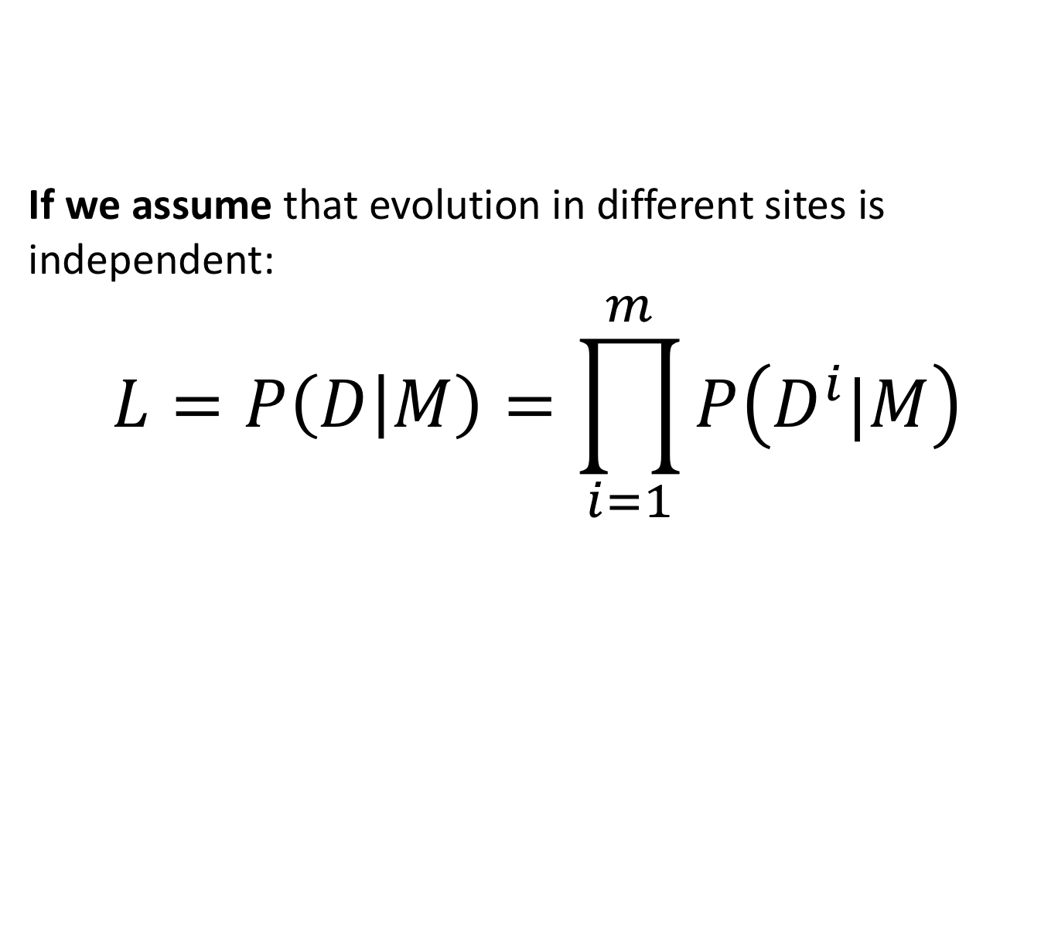
ML in practice
If we assume that evolution in different sites is independent:
$$L=P\left(D | M\right)=\prod_{i=1}^{m}{P\left(D^{i}|M\right)}$$
The likelihood of the tree is the product of the likelihood at each site
This means we have to perform some calculations at each site $i$

Slide 36
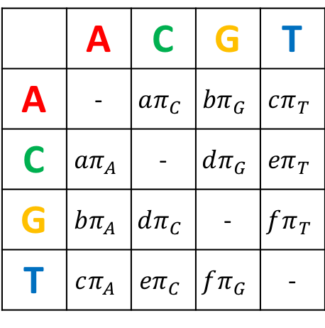
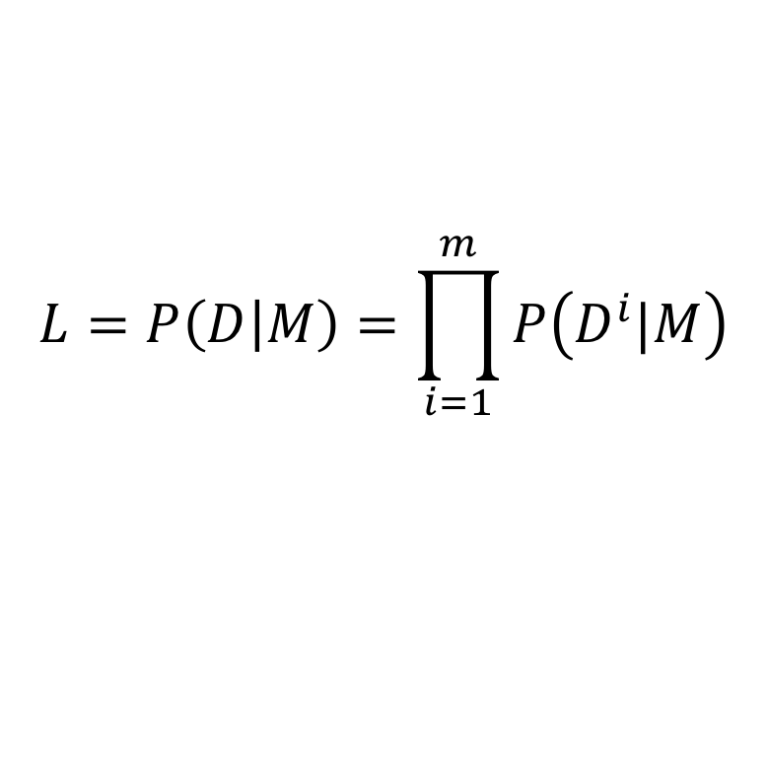
WTF
$$L=P\left(D | M\right)=\prod_{i=1}^{m}{P\left(D^{i}|M\right)}$$
Q_{GTR} =
 | A | C | G | T
A | - | $$aπ_{C}$$ | $${bπ}_{G}$$ | $$cπ_{T}$$
C | $$aπ_{A}$$ | - | $$dπ_{G}$$ | $${eπ}_{T}$$
G | $${bπ}_{A}$$ | $$dπ_{C}$$ | - | $$fπ_{T}$$
T | $$cπ_{A}$$ | $${eπ}_{C}$$ | $$fπ_{G}$$ | -

Slide 37
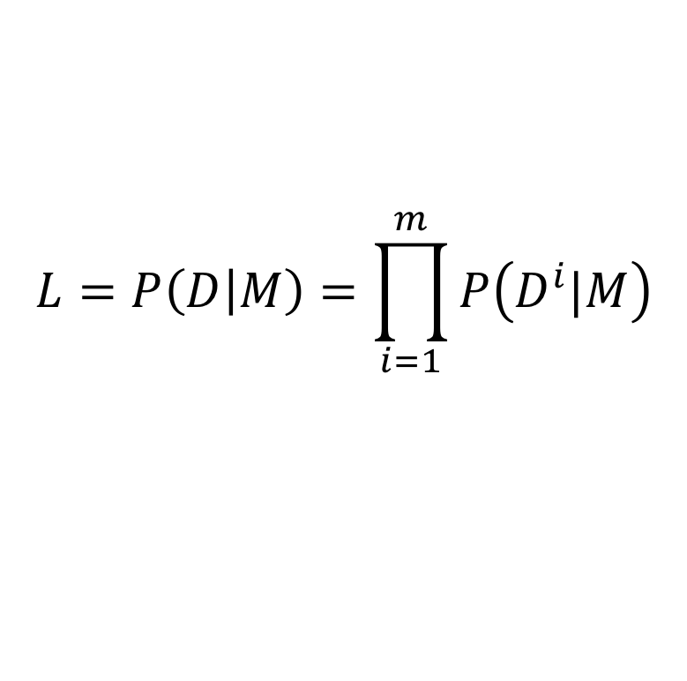
Putting it all together: Process
$$L=P\left(D | M\right)=\prod_{i=1}^{m}{P\left(D^{i}|M\right)}$$
Propose a starting tree
often via Parsimony or Neighbor-Joining
Calculate Likelihood for the tree site by site
Propose a new tree (branch swapping)
Calculate Likelihood for the new tree
Decide whether or not to keep the tree (Is it better?)
Repeat 3 through 5 until you can’t find a better tree
Nonparametric bootstrapping used for statistical support
The above process is repeated for each bootstrap replicate

Slide 38
Given a tree…
Alignment
Tree Hypothesis (one of many)
AG…
TA…
GG…
GC…
What is the probability of observing our data?

Slide 39
To find the probability of the tree producing the observed states, we need to know the probability of change from one state to another (e.g. from an A to a T)
AG…
?
TA…
GG…
GC…

Slide 40
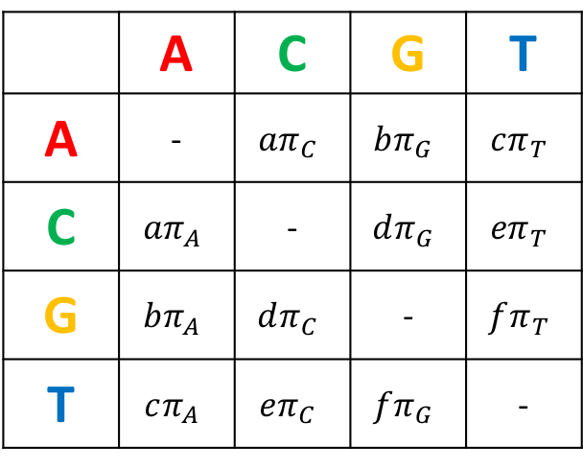
We can get this by first incorporating time into our instantaneous rate matrix (Q):
To:
Q =
 | A | C | G | T
A | - | $$aπ_{C}$$ | $${bπ}_{G}$$ | $$cπ_{T}$$
C | $$aπ_{A}$$ | - | $$dπ_{G}$$ | $${eπ}_{T}$$
G | $${bπ}_{A}$$ | $$dπ_{C}$$ | - | $$fπ_{T}$$
T | $$cπ_{A}$$ | $${eπ}_{C}$$ | $$fπ_{G}$$ | -
From:

Slide 41
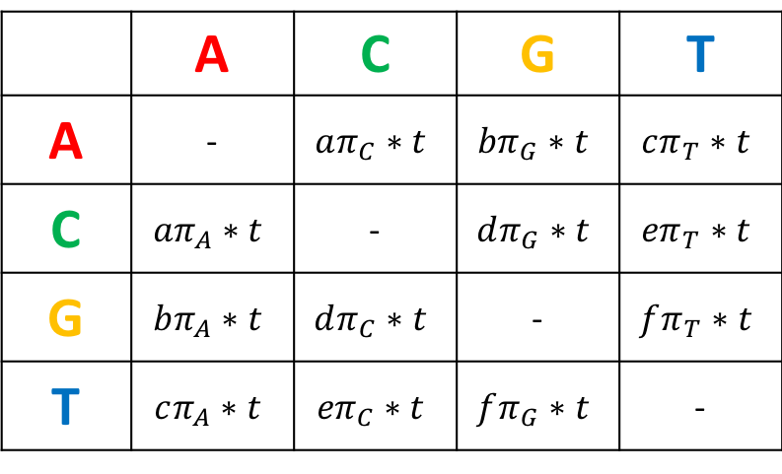
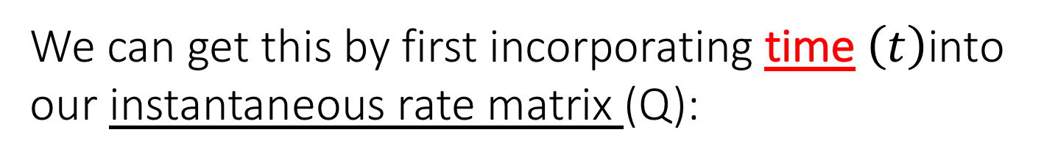
We can get this by first incorporating time $\left(t\right)$into our instantaneous rate matrix (Q):
To:
Q*t =
 | A | C | G | T
A | - | $$aπ_{C}∗t$$ | $${bπ}_{G}∗t$$ | $$cπ_{T}∗t$$
C | $$aπ_{A}∗t$$ | - | $$dπ_{G}∗t$$ | $${eπ}_{T}∗t$$
G | $${bπ}_{A}∗t$$ | $$dπ_{C}∗t$$ | - | $$fπ_{T}∗t$$
T | $$cπ_{A}∗t$$ | $${eπ}_{C}∗t$$ | $$fπ_{G}∗t$$ | -
From:

Slide 42
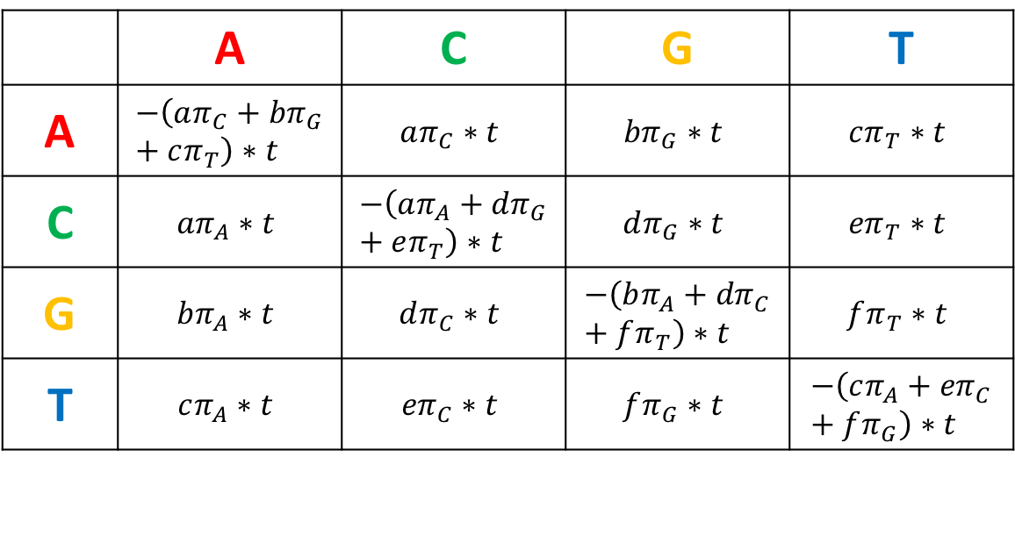
We can get this by first incorporating time $\left(t\right)$into our instantaneous rate matrix (Q):
Q*t =
To:
 | A | C | G | T
A | $$−\left(aπ_{C}+{bπ}_{G}+cπ_{T}\right)∗t$$ | $$aπ_{C}∗t$$ | $${bπ}_{G}∗t$$ | $$cπ_{T}∗t$$
C | $$aπ_{A}∗t$$ | $$−\left(aπ_{A}+{dπ}_{G}+eπ_{T}\right)∗t$$ | $$dπ_{G}∗t$$ | $${eπ}_{T}∗t$$
G | $${bπ}_{A}∗t$$ | $$dπ_{C}∗t$$ | $$−\left(bπ_{A}+{dπ}_{C}+fπ_{T}\right)∗t$$ | $$fπ_{T}∗t$$
T | $$cπ_{A}∗t$$ | $${eπ}_{C}∗t$$ | $$fπ_{G}∗t$$ | $$−\left(cπ_{A}+{eπ}_{C}+fπ_{G}\right)∗t$$
From:
Incorporate rates of NO change

Slide 43
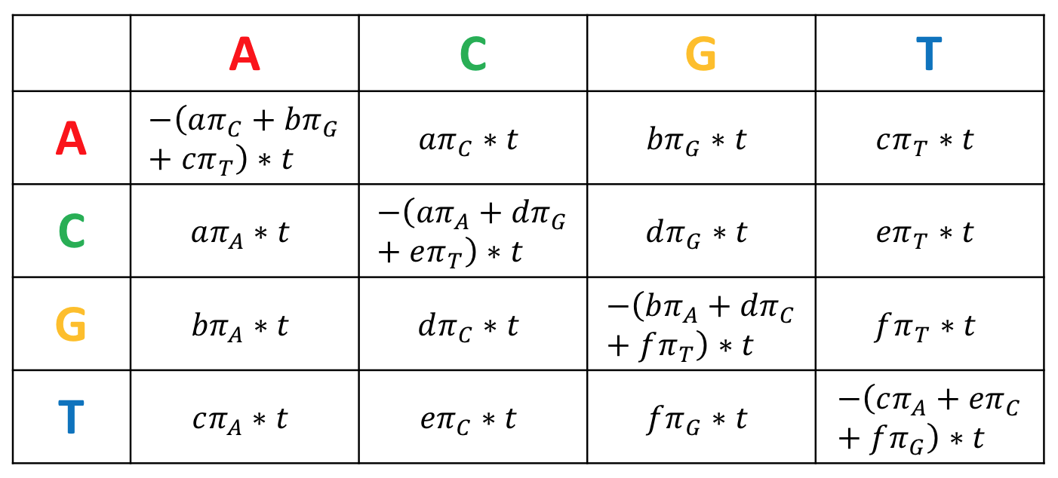
The transition probability matrix P is found by:
e
P(t) = e^{Q*t} =
Don’t ask me why this works…

Slide 44
This results in a transition probability matrix, for example, this one:
To:
P(t)=
 | A | C | G | T
A | .406 | 1.35 | 1.49 | 1.22
C | 1.105 | .273 | 1.35 | 2.46
G | 1.35 | 1.08 | .67 | 1.02
T | 1.22 | 2.014 | 1.01 | .403
From:

Slide 45
Alignment
Tree Hypothesis (one of many)
AG…
TA…
GG…
GC…
To compute the likelihood of the tree, we need to first compute the probability of this particular tree producing the observed states for each character

Slide 46
Alignment
Tree Hypothesis (one of many)
AG…
A
T
G
G
TA…
GG…
?
GC…
?
?
Character states for site #1 mapped onto tree

Slide 47
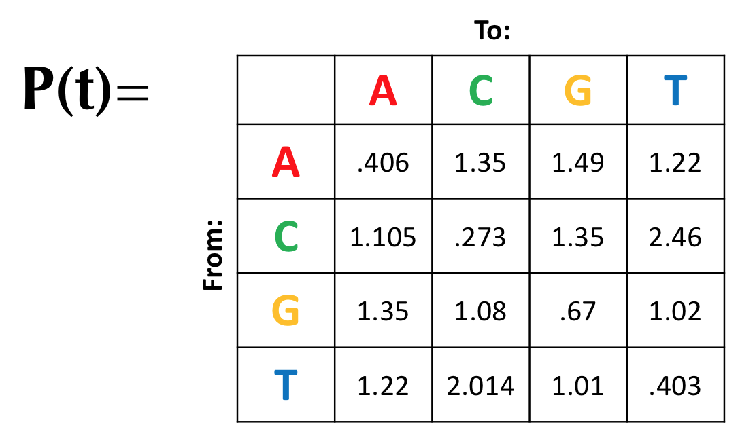
Computationally, this is done by computing the conditional likelihood for subtrees:
A
T
G
G
?
?
?

Slide 48
Computationally, this is done by computing the conditional likelihood for subtrees:
For character #1…
For this subtree…
A
T
0.2
0.4
?
We have some observed states, and need to consider all possible ancestral states
Credit: I stole all of this from Jeremy Beaulieu’s Spring 2018 Phylogenetics course

Slide 49
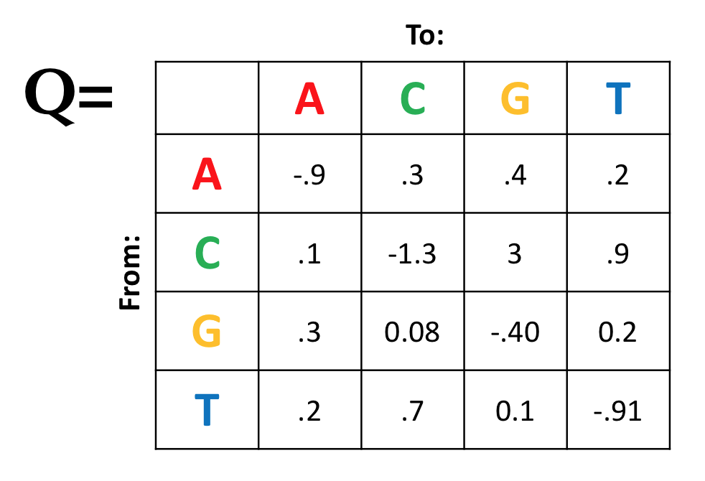
A
T
0.2
0.4
?
Given all possible states for “?”, what is the probability of transition to A?

Slide 50
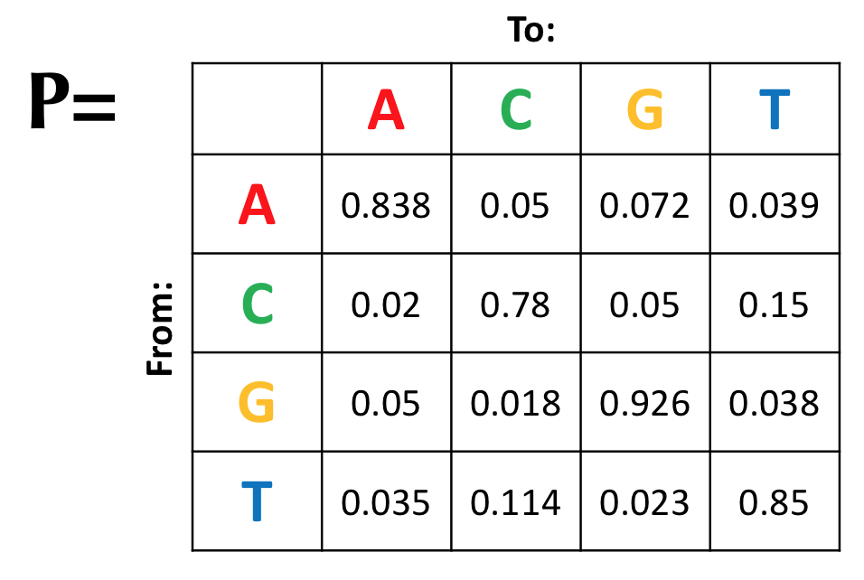
A
T
e^{Q*0.2}
0.2
0.4
?

Slide 51
A
T
e^{Q*0.2}
0.2
0.4
?
?→A | 0.838 | 0.02 | 0.05 | 0.035

Slide 52
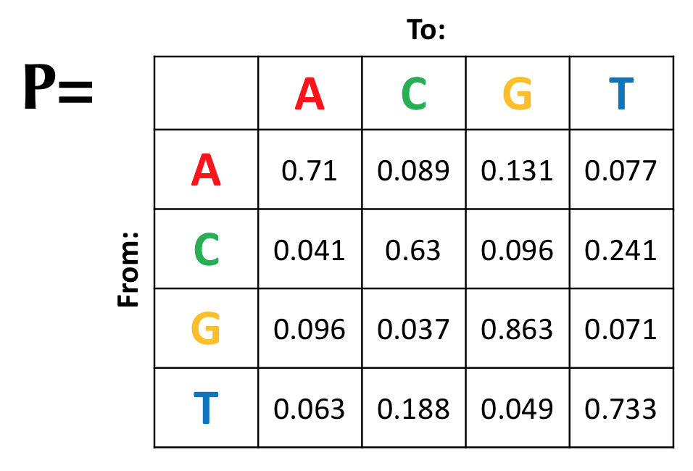
A
T
e^{Q*0.4}
0.2
0.4
?
?→A | 0.838 | 0.02 | 0.05 | 0.035
?→T | 0.077 | 0.241 | 0.071 | 0.733

Slide 53
A
T
0.2
0.4
?
?→A | 0.838 | 0.02 | 0.05 | 0.035
?→T | 0.077 | 0.241 | 0.071 | 0.733
? | 0.064 | 0.005 | 0.004 | 0.026
^{X}

Slide 54
A
T
0.2
0.4
?
?→A | 0.838 | 0.02 | 0.05 | 0.035
?→T | 0.077 | 0.241 | 0.071 | 0.733
? | 0.064 | 0.005 | 0.004 | 0.026
^{X}
^{=0.098}
Summing these gives the conditional likelihood for the subtree

Slide 55
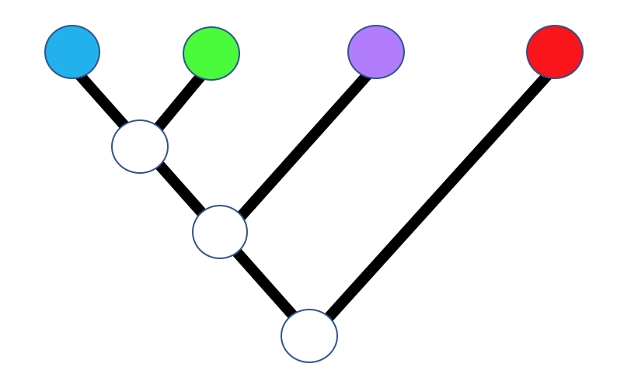
Following this process down the tree gives the likelihood of the full tree (the likelihood at the root) for nucleotide position #1

Slide 56
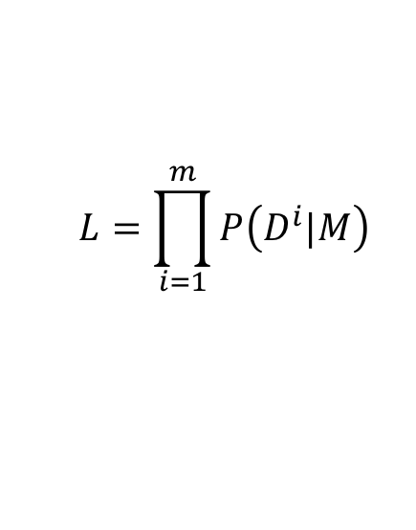
AG…
Multiplying these likelihoods across all characters gives the likelihood of the tree
TA…
GG…
$$L=\prod_{i=1}^{m}{P\left(D^{i}|M\right)}$$
GC…

Slide 57
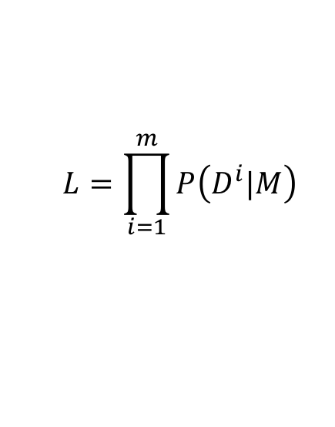
Multiplying these likelihoods across all characters gives the likelihood of the tree
Usually reported as ln(L)
AG…
TA…
$$L=\prod_{i=1}^{m}{P\left(D^{i}|M\right)}$$
GG…
GC…

Slide 58
How do we know which model to derive Q from?

Slide 59
How do we know which model to derive Q from?
More complicated models will almost always “fit” the data better
Don’t want to over-parameterize

Slide 60
Model testing: Approach
jModelTest uses another program (PhyML) to apply different models of DNA sequence evolution to your dataset
jModelTest Approach
1) Construct (or input) a tree
2) Calculate the maximum likelihood estimates of all model parameters
3) Calculate the log likelihood of the tree
3) Compare models to select the best one using some criterion
AIC
BIC
hLRT

Slide 61
AIC and BIC
AIC = Akaike Information Criterion
BIC = Bayesian Information Criterion
AIC = -2L + 2K
BIC = -2L + K*log(n)
L = log likelihood
K = number of parameters in the model
n = number of characters (nucleotides)
Penalty for the number of parameters to prevent over-parameterization.
BIC places a greater penalty on models with many parameters

Slide 62
Hierarchical LRT
2δ = 2[ ln(L₁) – ln(L₀) ]
ln(L₁) = likelihood score for more complex model
ln(L₀) = likelihood score for simpler model
2δ is approximately Χ² distributed
Degrees of freedom (df) = difference in number of parameters between models.
If 2δ > Χ² critical value, the null model is rejected
The alternative model becomes the new null model
Continue until there is no longer a significant difference between models

Slide 63
Complexity

Slide 64
PhyML (Guindon et al 2010)
Relatively efficient
Can employ several different models of sequence evolution
RAxML (Stamatakis 2006)
Uses GTR model only
Powerful program, very useful for large datasets
Has different bootstrap algorithms
“traditional” bootstrap
Rapid bootstrap algorithm (Stamatakis et al. 2008)
“between 18 and 495 times faster” than other programs
Useful for very large datasets

Slide 65
Suggestions for today’s lab
Make sure to save the ModelTest output
Focus on building the trees
Type all commands (don’t try to copy/paste)
The ‘tab’ key can autocomplete file names
Don’t take shortcuts (don’t run more than one instance of PhyML or RAxML at the same time)
Don’t worry if you don’t finish the RAxML runs- do your best

Slide 66
Serial vs. Parallel Computing
Start
Start
Bootstrap 1
Distribute Bootstrap Replicates
Bootstrap 2
Bootstrap 1
Bootstrap 2
Bootstrap 3
Bootstrap 4
Bootstrap 3
Collect Results
Bootstrap 4
Done
Done

Slide 67
Parallel Computing
OpenMPI
MPI = Message Passing Interface
Programs must be written to take advantage of its capabilities
Can speed up computing dramatically, but can be very memory hungry
Example command:
mpirun –n 4 phyml –i helo-atp8.phy
Tell openMPI the number of processors to use
Feed commands to the MPI-enabled program you want to use
Call to OpenMPI

